Slide 1
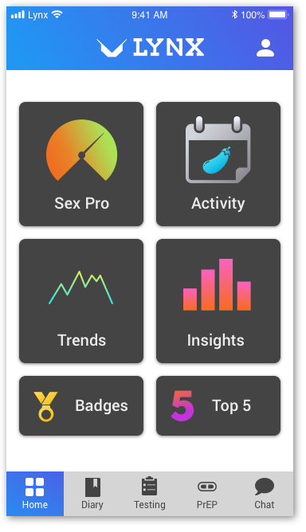
Developing a Novel Mobile App to Support HIV Testing and PrEP Uptake Among Young MSM: The LYNX Study
Authors: Albert Liu, Kenneth Coleman, Janie Vinson, Ryan Muench, Kelly Bojan, Pedro Alonso Serrano, Temitope Oyedele, Amayvis Garcia, Elizabeth Enrique-Bruce, Patricia Emmanuel, Jeb Jones, Kate Muessig, Casey Horvitz, Shelby Mullin, Jessica Roberts, Susan Buchbinder, Patrick Sullivan, Lisa Hightow-Weidman, Hyman Scott
Background & Methods
Young men who have sex with men (YMSM) have high HIV/STI incidence and low uptake of HIV/STI testing and PrEP in the US
Mobile health apps are a promising approach to increase engagement of youth in HIV prevention.
As part of the ATN iTech U19, we developed and tailored the LYNX app to increase HIV/STI testing and PrEP uptake through iterative focus groups and evaluated its acceptability and feasibility through an open pilot among YMSM aged 15-24 in Chicago and Tampa
LYNX components to increase HIV/STI testing and PrEP uptake according to IMB model
Goal | Information | Motivation | Behavioral Skills
Increase HIV/STI testing | Personalized HIV risk assessment (Sex Pro) Sexual history diary and partner tracking | Testing reminders HIV/STI testing diary and Sex Pro | Home-based HIV/STI testing options and instructions GPS-based testing site and linkage to HIV care information
Increase PrEP uptake | PrEP educational materials Roadmap on how to get on PrEP | Testimonials of peers on PrEP Impact of PrEP on Sex Pro score | Links to youth PrEP clinics Tips for insurance/access issues Chat feature to assist with PrEP navigation

Slide 2
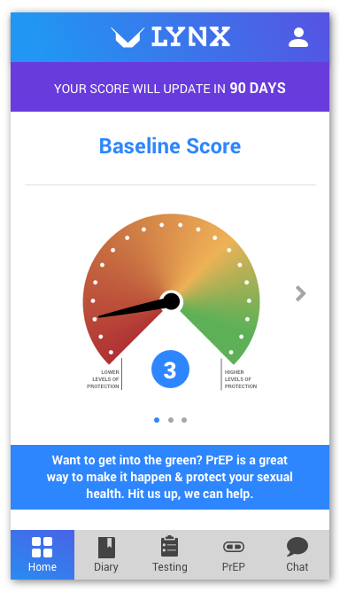
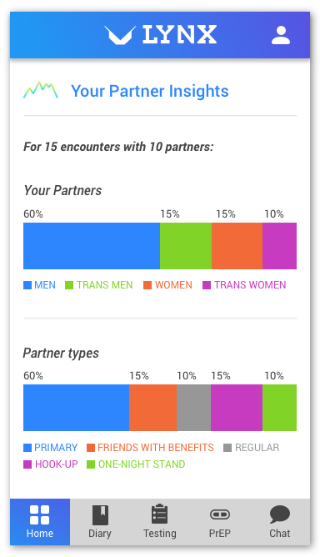
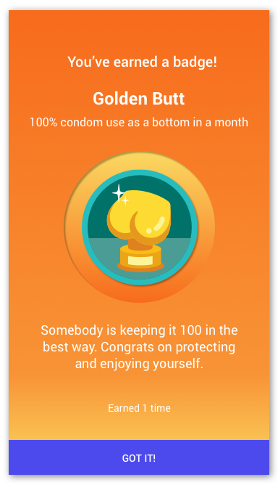
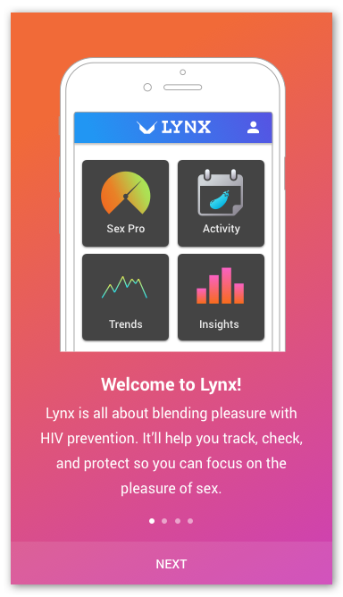
LYNX Focus Groups (N=30)
30 YMSM participated in 2 focus groups
Mean age 20, 43% Latino, 43% Black
App was well-received, especially the sexual diary
Recommendations
SexPro: suggested better explanation of scores
Interest in gamification and data feedback
Make the goal of LYNX clearer during app onboarding

Slide 4
2 month LYNX Open Pilot (N=15)
Conclusions
LYNX feasible and acceptable
Next steps: pilot RCT & comparative effectiveness RCT
93% used app ≥ 2 times (Median 7 sessions)
Median # features accessed: 12/16
App was useful 78% Agree
Overall satisfied: 85% Agree
Median SUS Score: 71 (good range)
Most helpful components of app
PrEP info
Ordering test kits/supplies
Locator to find testing/PrEP site
Sexual diary
Reminders for HIV testing

